Slide 1
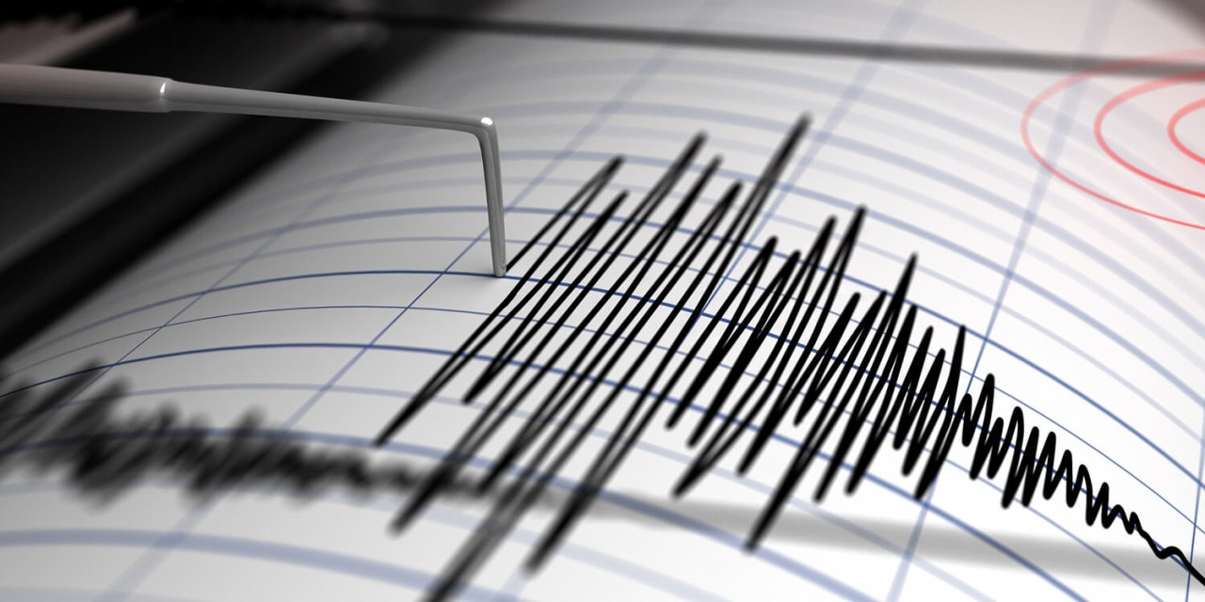

Investigating AI-DRiven innovations in earthquake prediction and detection Abhinav thapa

Slide 2
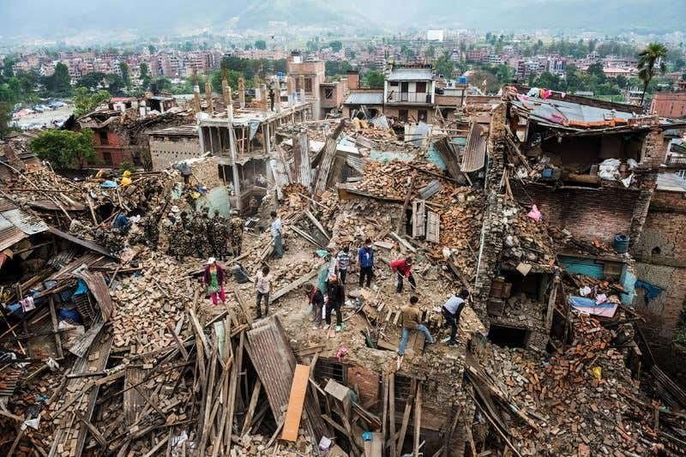
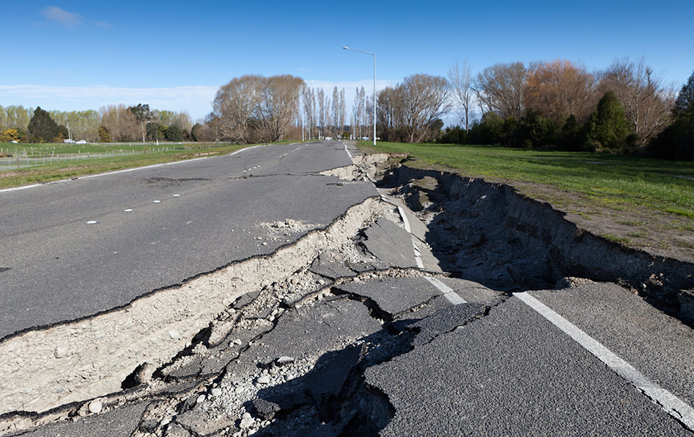
BACKGROUND
10,000 deaths per year
Can trigger other natural disasters e.g Landslides
Over 120 Million people displaced or injured
Occur usually without warning

Slide 3
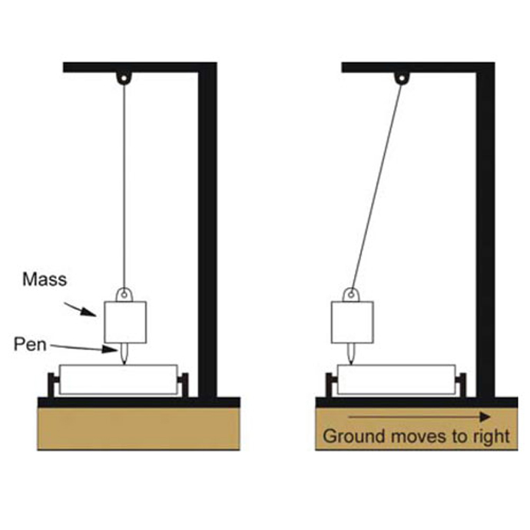
Traditional methods
Lots of seismic data available
This data complex and highly non- linear
Lots more research now going into AI Innovative solutions

Slide 4
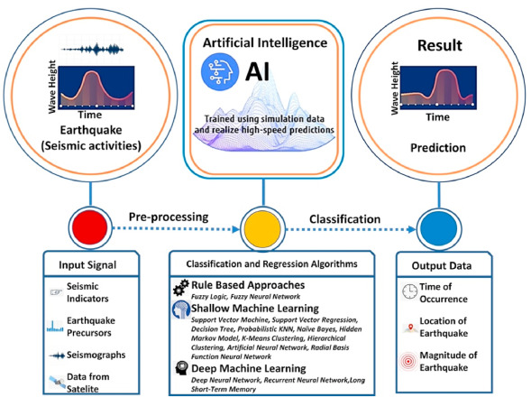
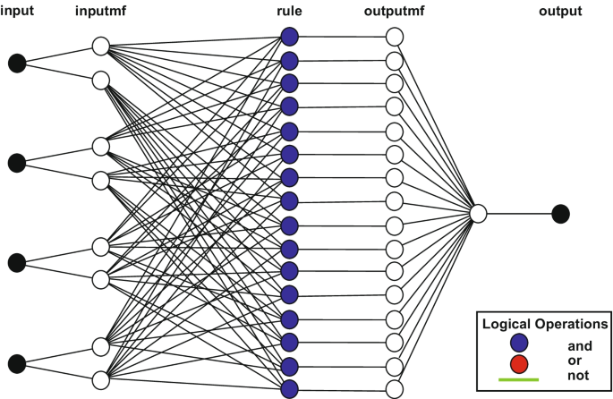
Machine learning -ANFIS
Excels at capturing non-linear relationships
Helps to understand noise and 100% of the data
Limits in magnitude
Needs accurate and comprehensive datasets

Slide 5
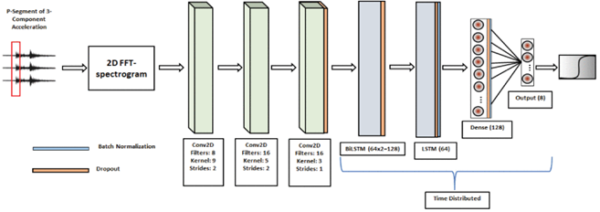
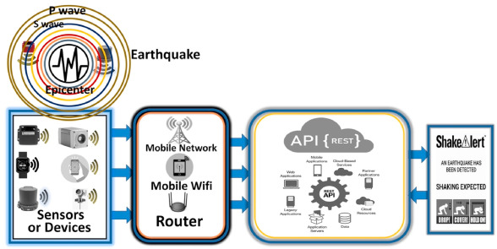
Deep lEARNING (DL)
Most recently used model
Detected P-waves at accuracy of 98.8%
Learn complex abstraction by building hierarchy of abstractions
CrowdQuake - IoT

